Slide 1

Examining a link between restaurants
and gentrification in Miami
ETL Data project by CHAMPS:
Monica Alarcon, Abraham Benaim, Craig Hall

Slide 2
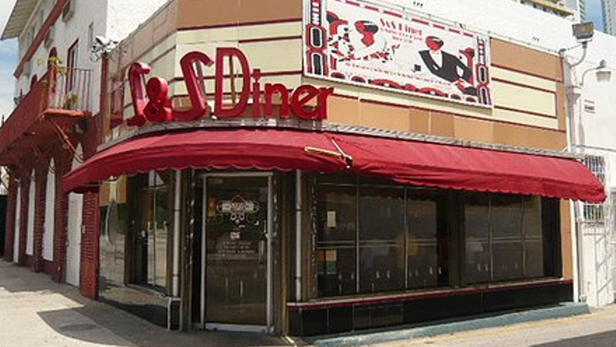
PREMISE
We set out to find a correlation between
the prices that restaurants charge and gentrification.

Slide 3
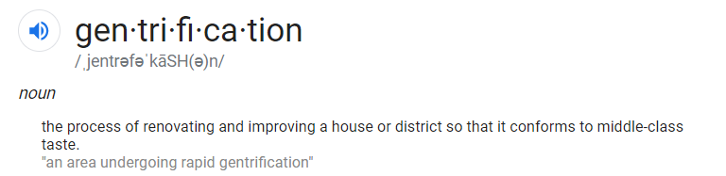

We theorized we could identify gentrified neighborhoods by examining zip codes where average rental rates account for more than 30% of the average income in those same zip codes (using the 30% rule-of-thumb for “income spent on rent” as a standard).
We would then examine the price indexes for restaurants in those neighborhoods to determine a correlation.

Slide 4
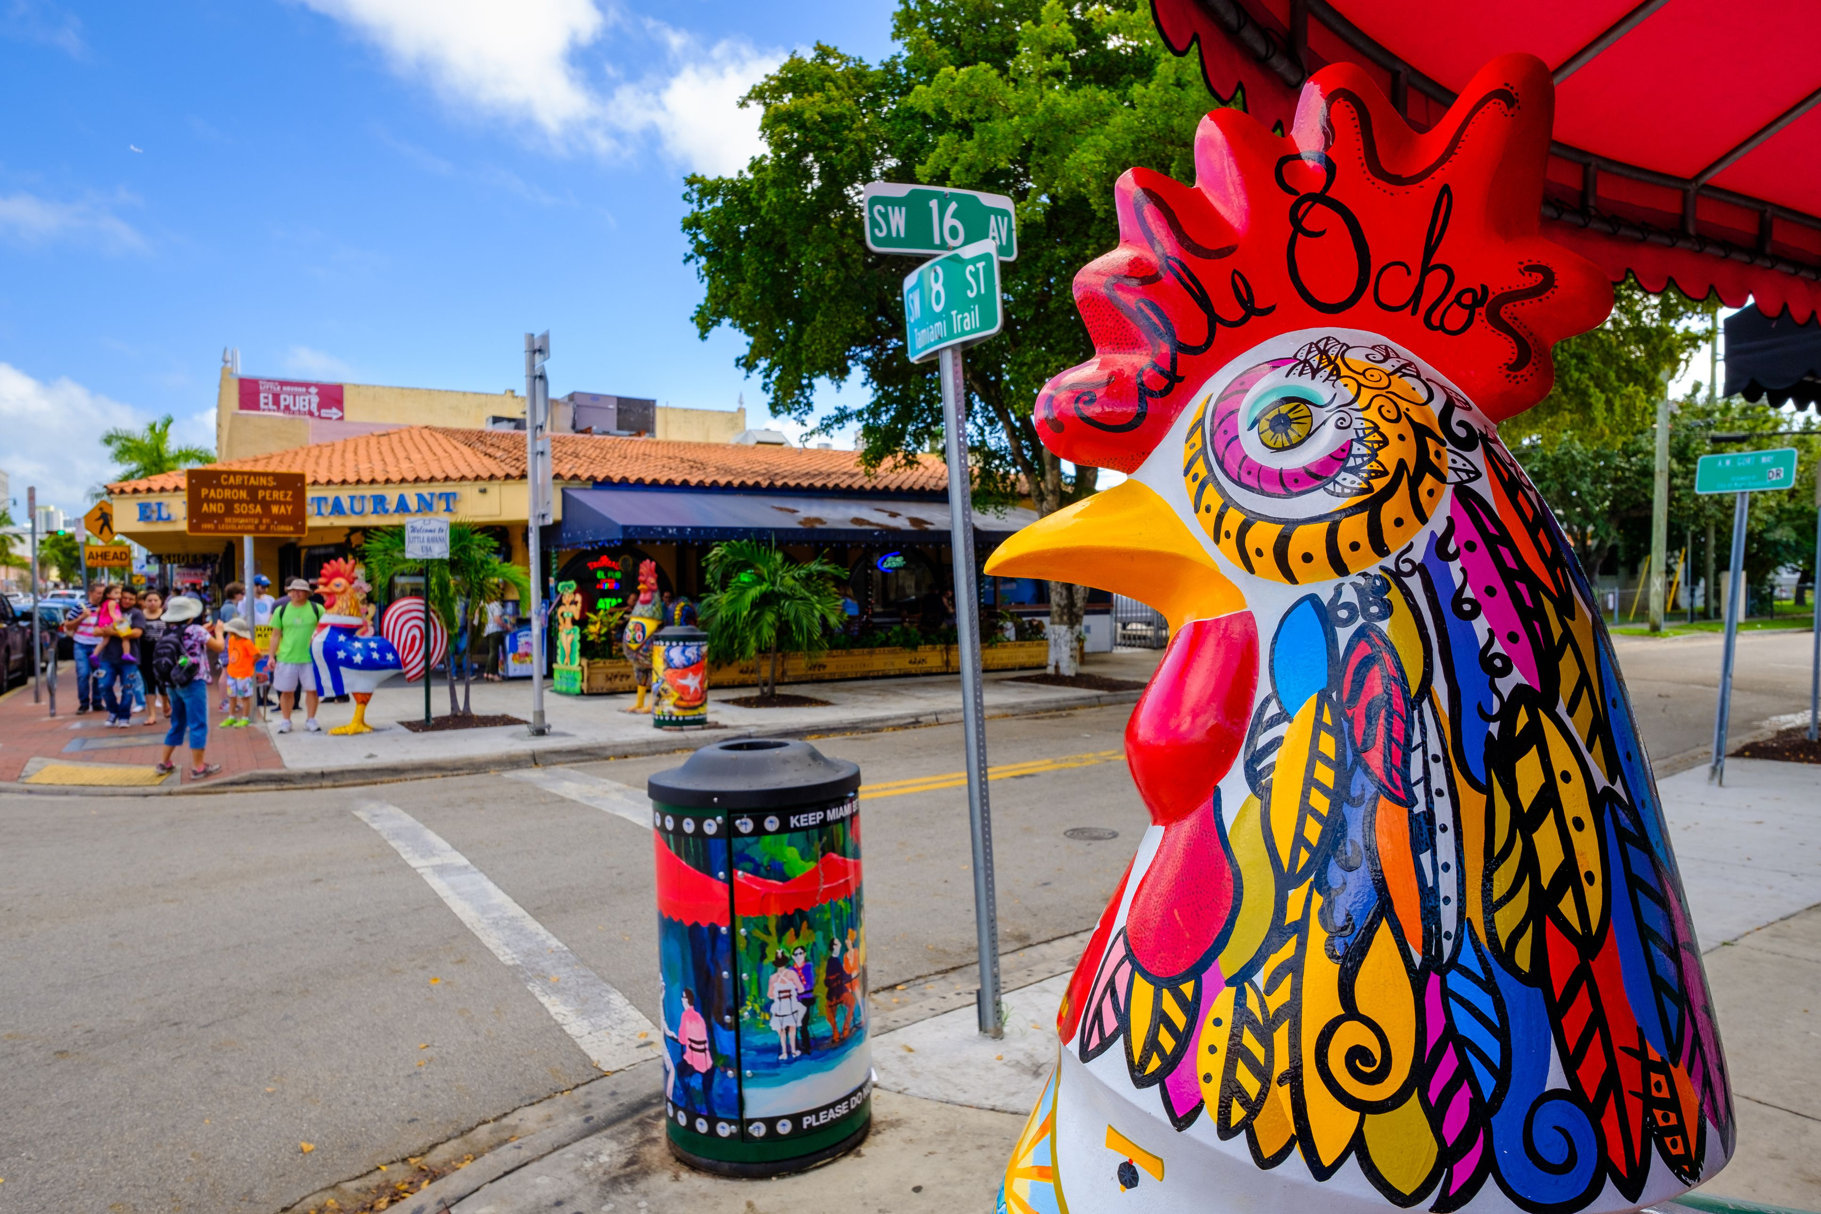
Resources and Processes
Zillow – downloaded CSV of home and rent values in Miami. Imported into Python. Removed unnecessary columns, and zip codes with NaN values.
Census.gov – downloaded CSV of census data for average income by census tract in Miami-Dade. Imported into Python; used Pandas to clean and transform the list.
Used Pandas to join the rental rates by zip code with the average income per zip code. From this joined data frame we created a “disparity” list: the 30 zip codes in Miami in which the rental rates most exceeded 30% of the average income.
Created SQL database to store all of the individual lists
Yelp – made API call to Yelp to pull restaurant name, address, zip code, and price index for each of the zip codes on our disparity list.
Used Pandas to join the restaurant data with the disparity list, so we could examine the price index of restaurants in the neighborhoods with the highest disparity. Created a PostgreSQL database.
# With additional time, would use MatPlotLib to chart the 30 neighborhoods with the highest disparity values and the prices of restaurants in those neighborhoods to chart the correlation between average restaurant price and neighborhoods identified as “gentrified.”

Slide 5
Extract
Transform
Load
Zillow
Python
PostgreSQL
Yelp
Census.gov

Slide 6
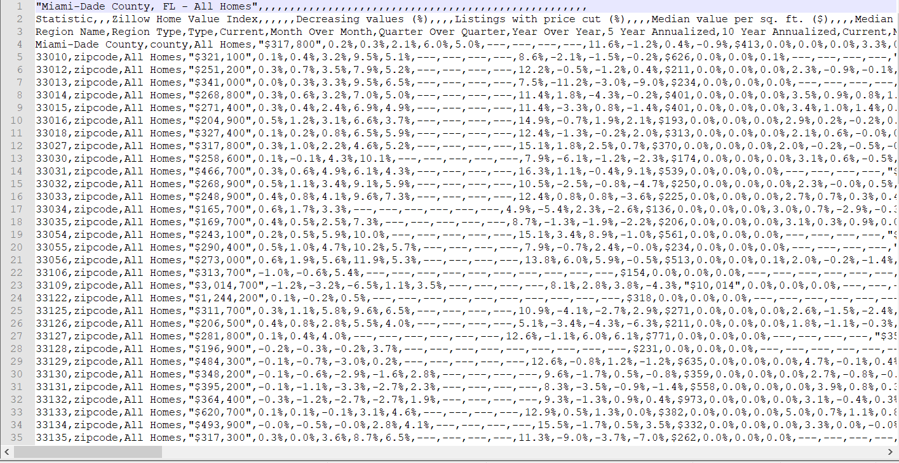
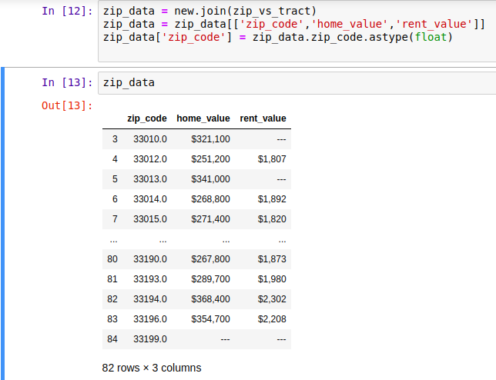
CSV data from Zillow
Cleaned data frame of Zillow data

Slide 7
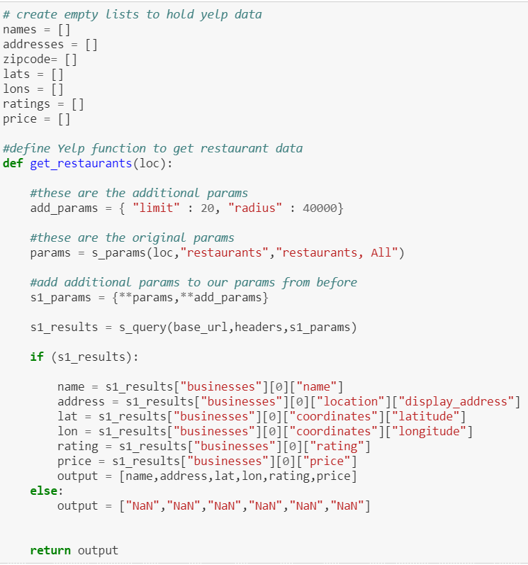
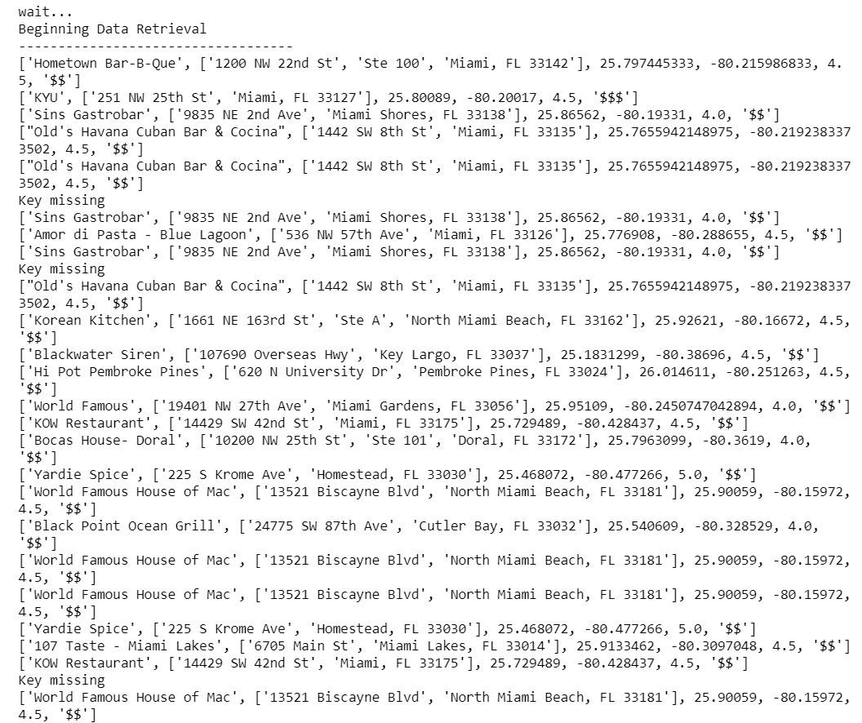
List results retrieved from Yelp API call
Python code creating empty lists and cycling through Yelp API to grab restaurant information

Slide 8
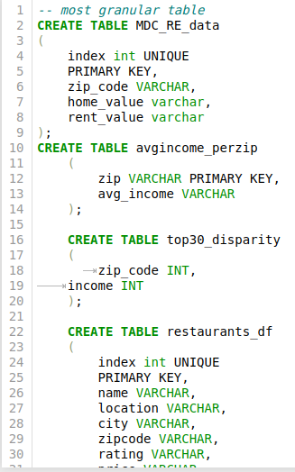
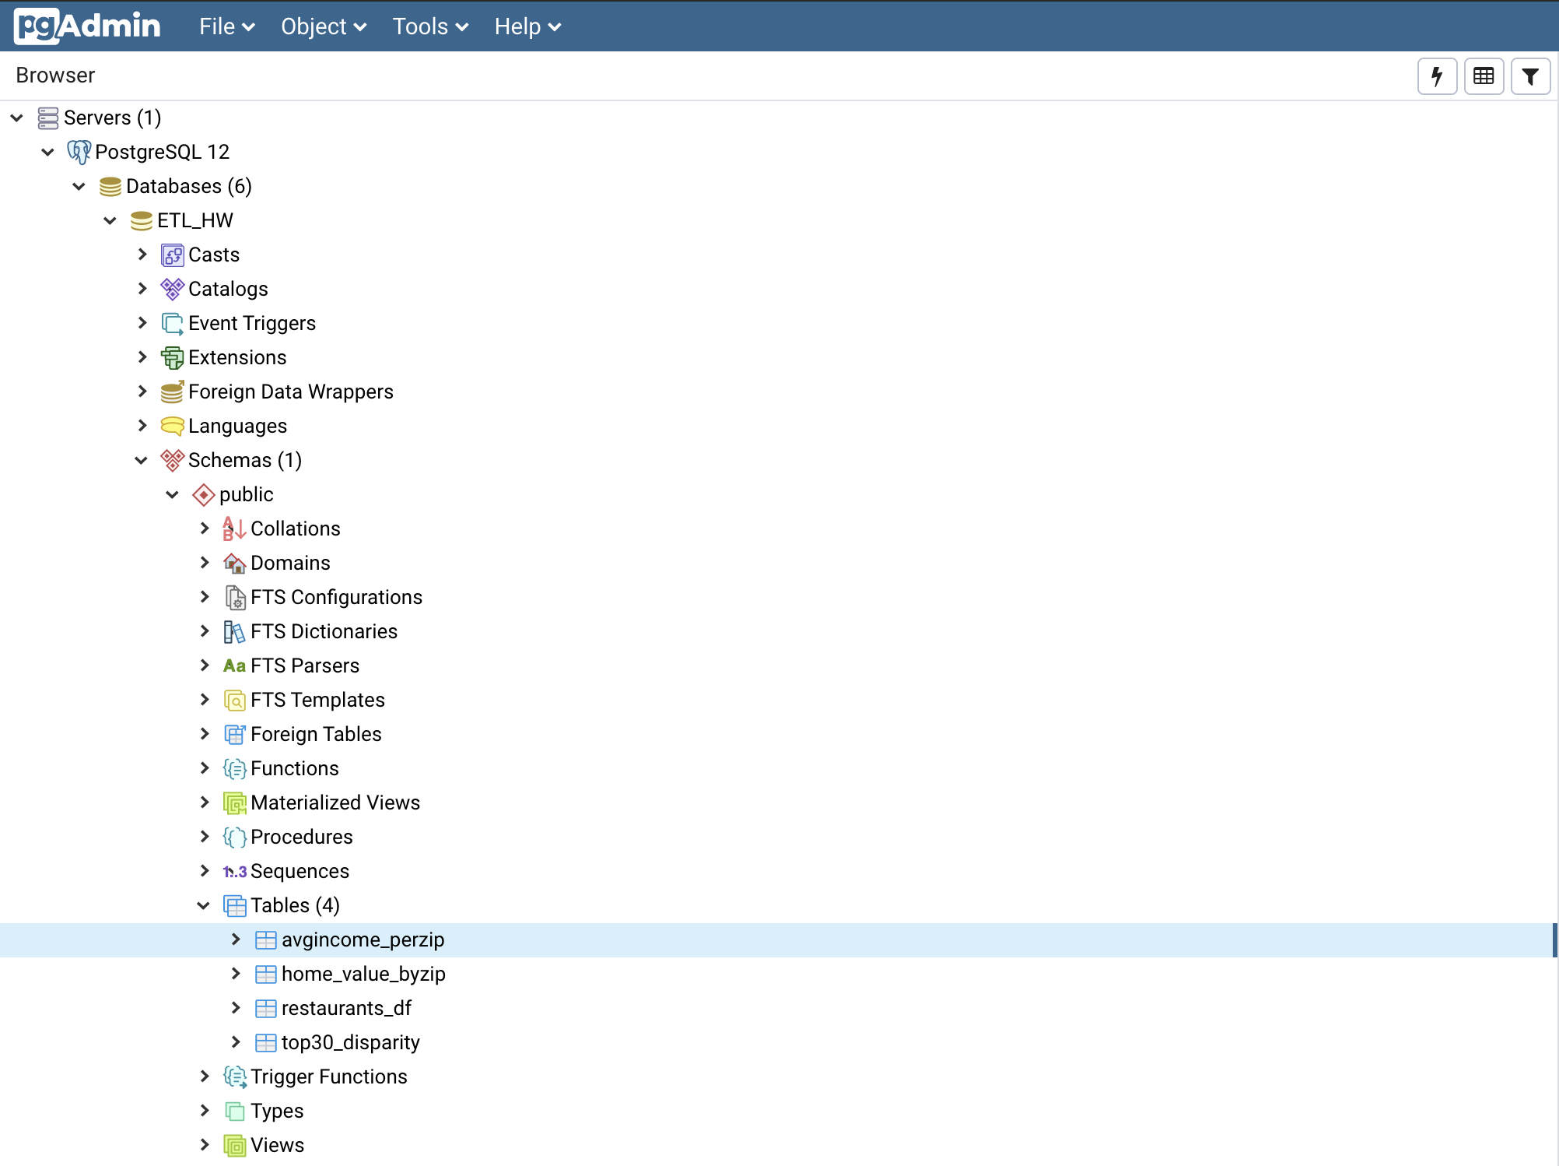
Table schema in PostgreSQL
Creation of tables in PostgreSQL

Slide 9
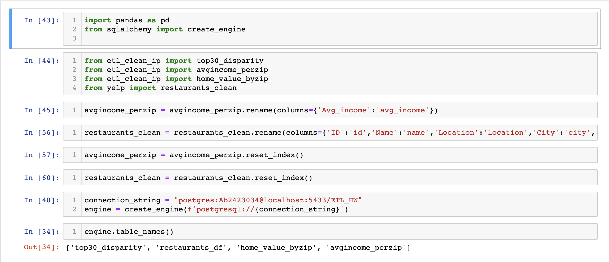
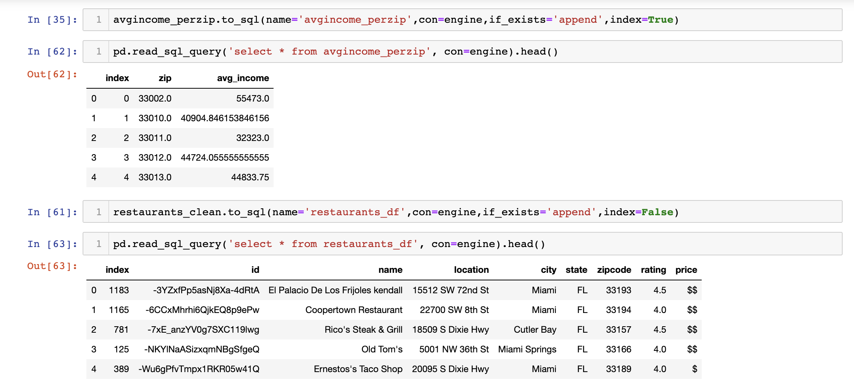
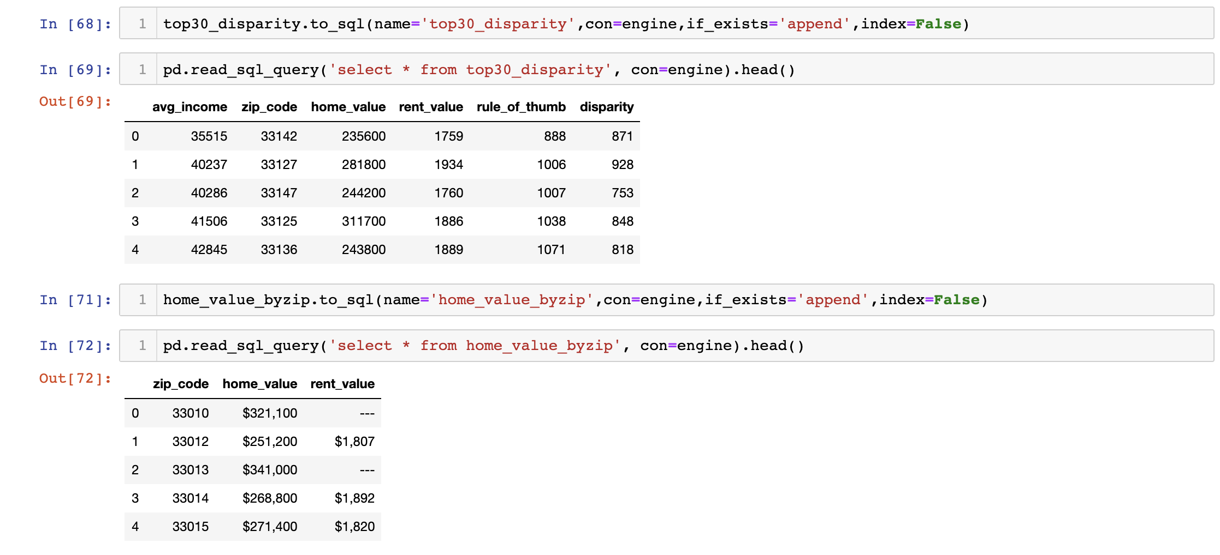
Feeding data to tables in PostgreSQL to
store restaurant data, average income,
home/rent value and disparity
Confirming and reading data from the SQL

Slide 10

SUMMARY: ETL
E – Extracted data from :
Zillow (CSV)
Census.gov (CSV)
Yelp (programmed API call)
T – transformed all data by deleting unnecessary columns, removing rows with NAN data, joined data from the three data sources
L – Loaded all data into SQL database. We chose SQL database because the data we are utilizing is dynamic, and can change frequently. By using SQL and the code we wrote, we would be able to pull this information at any point in time and easily update the restaurant or housing data, and could look at the correlation over a long period of time.

